Slide 1
Assignment 2 Longitudinal Data Analysis
Stefan Velev - r0924289
Adhithya Unni Narayanan - r0776057

Slide 2
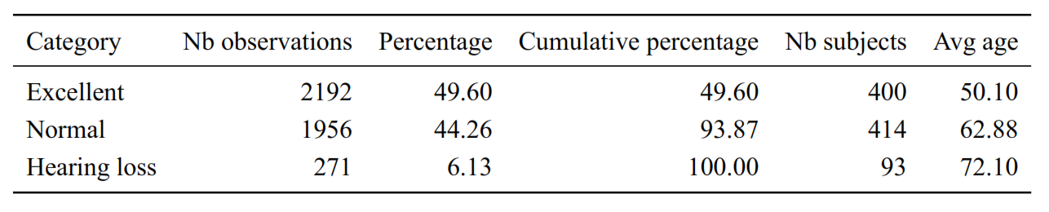
Data Trichotomization
We use existing medical literature and in congruence with the median to choose suitable cut of points.
Hearing Loss : y > 25dB
according to existing medical literature Clark (1981)
Normal hearing : 6dB < y ≤ 25dB
6dB is median value for all observations ≤ 25dB
Excellent hearing : y ≤ 6dB

Slide 3
Marginal and Mixed Models
Marginal model
Mixed Model
Generalized Estimating Equation
GEE
Gives population averaged effects (Marginal Probabilities)
Variate selection based on a greedy approach with Wald test
Variates: Age, Time, Age*Time, Age^2 and a learning effect
Cumulative Link Mixed Model
CLMM
Only with random intercept
Gives subject specific effects (Conditional Probabilities)
Variate selection based on a greedy approach and AIC
Variates: Age, Time, Age*Time, Age^2 and a learning effect

Slide 4
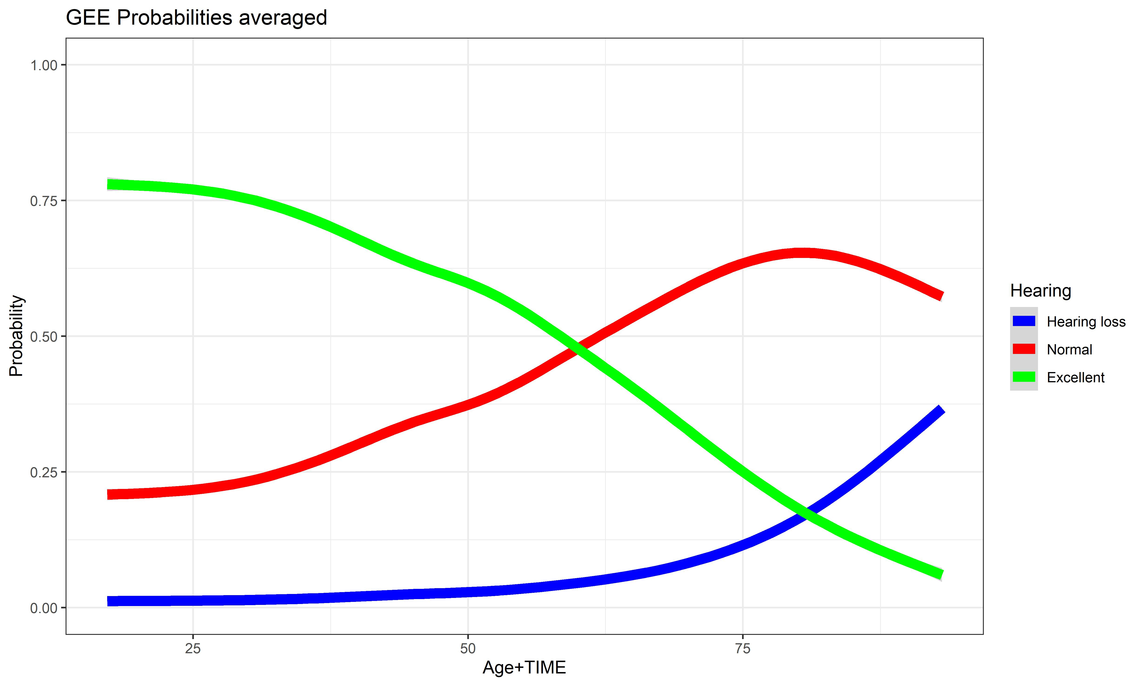
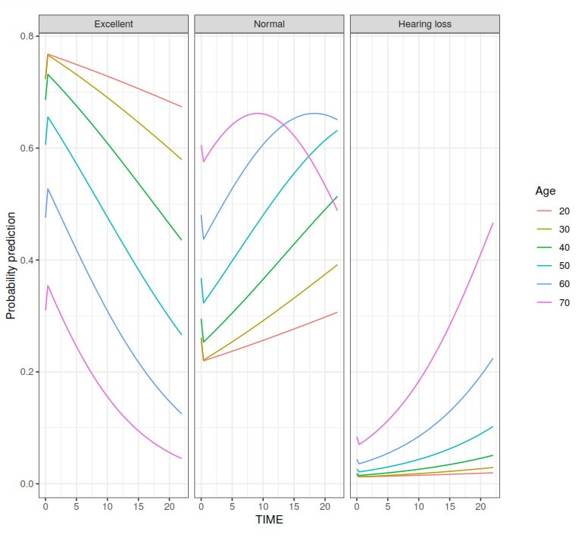
Marginal Effects model

Slide 5
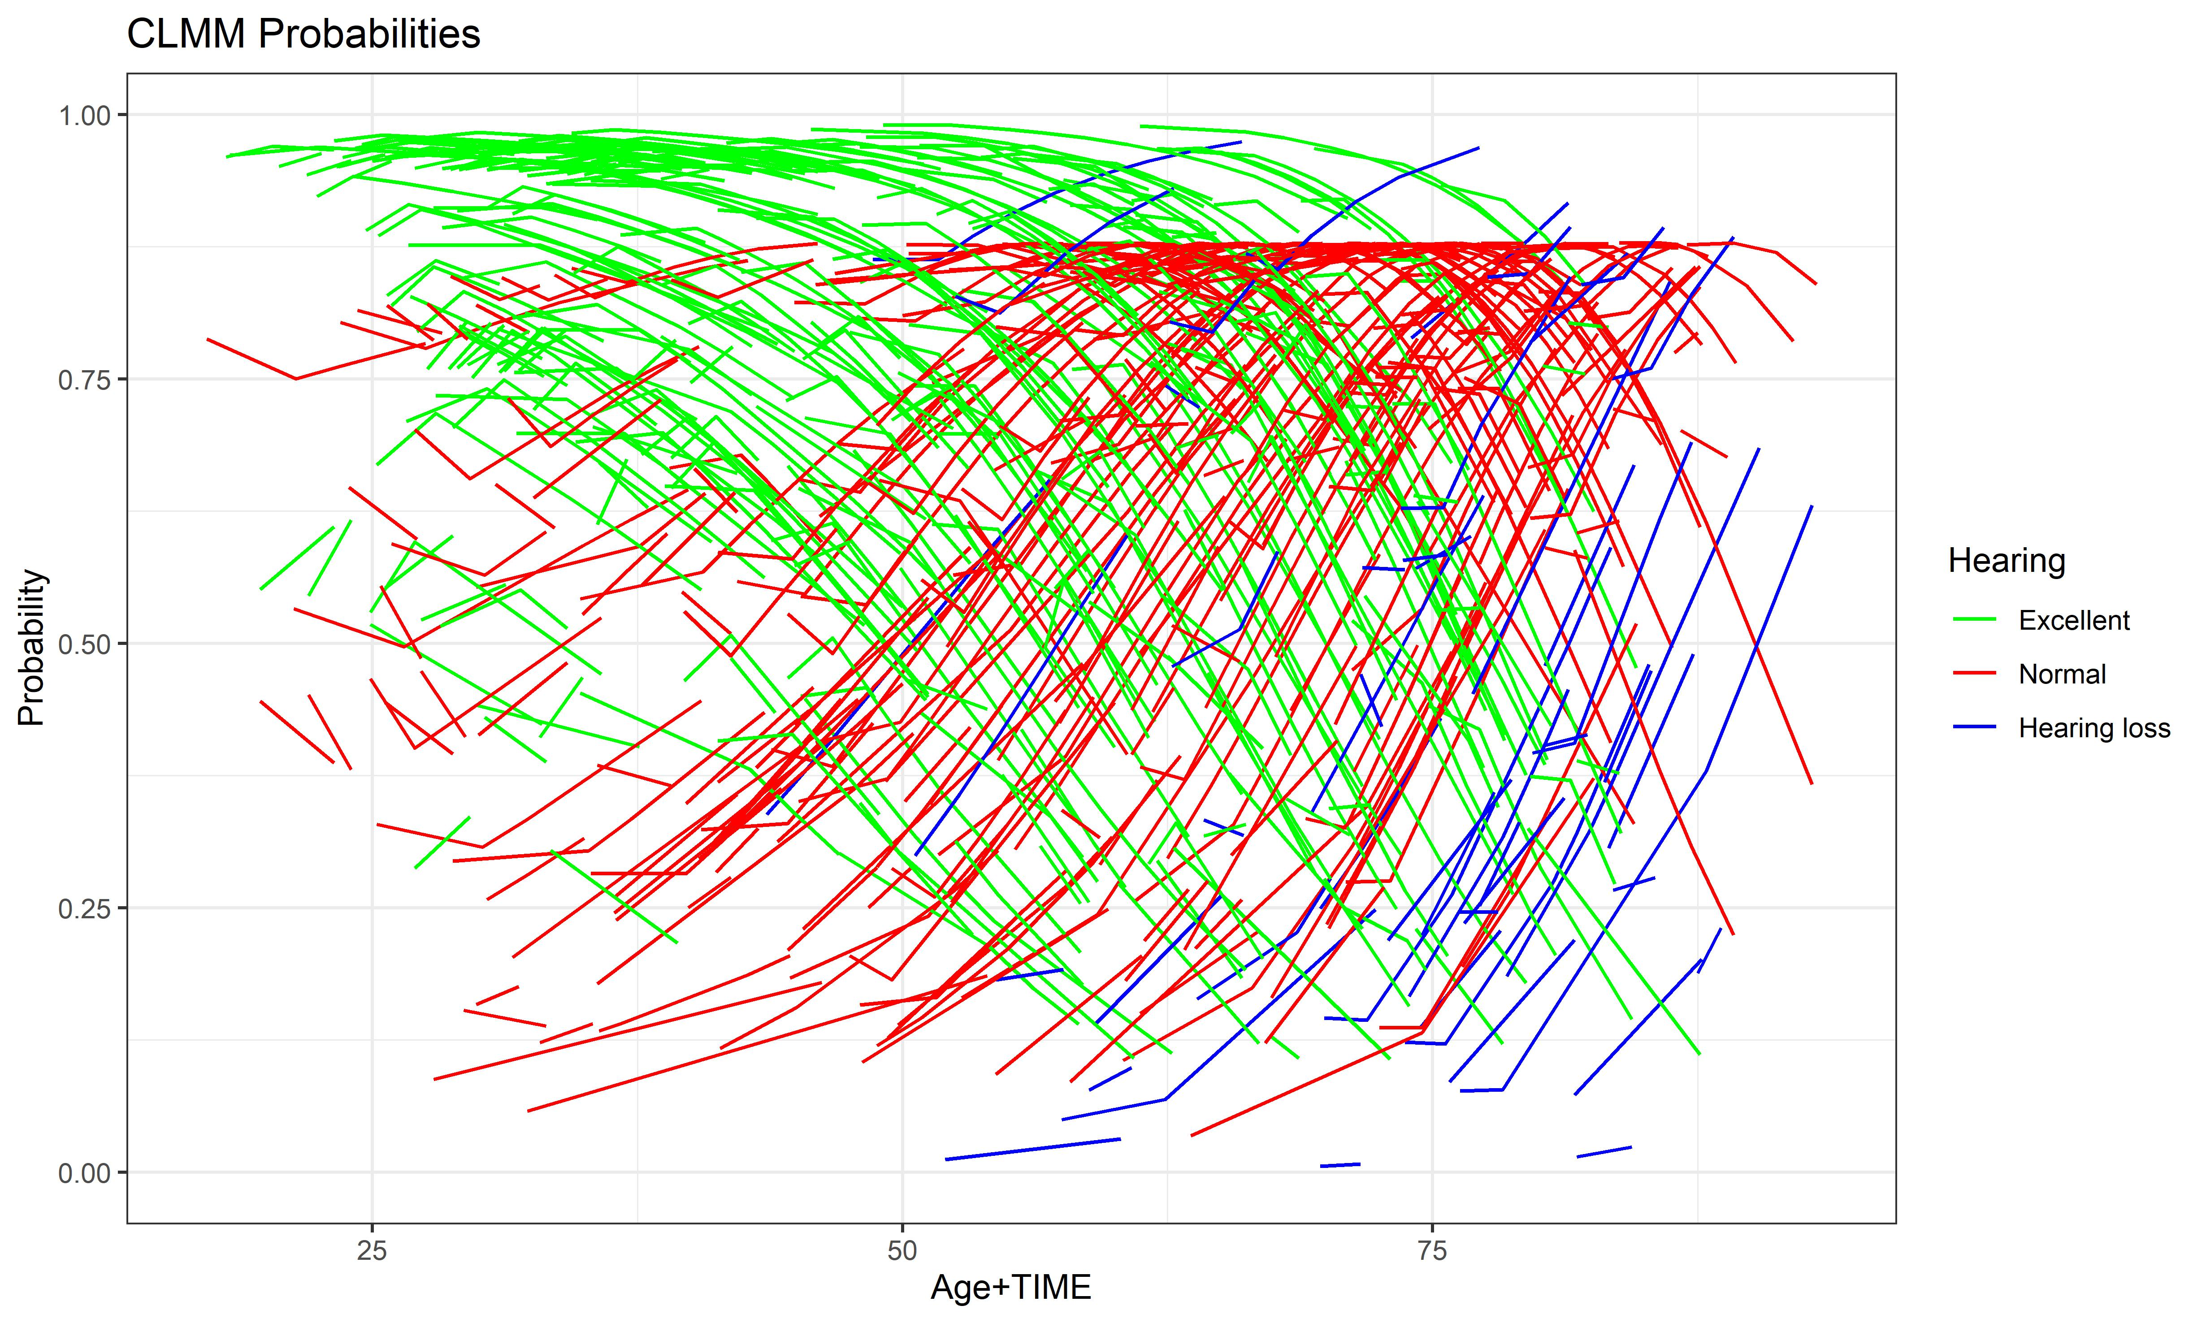
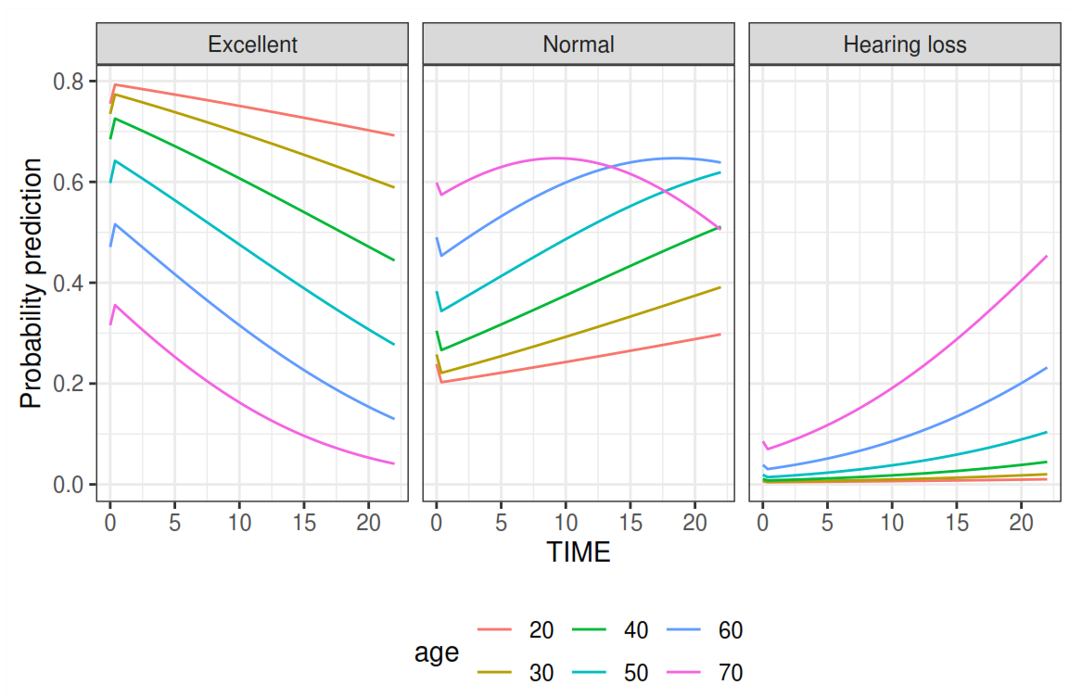
Mixed Effect
To infer the marginal evolution of hearing loss over time, we cannot simply set the random intercept equal to zero to calculate the prediction. This is because the expectation of a logit function is not equal to the logit of the expectation. We need to integrate the GLMM

Slide 6
Empirical Bayes prediction
Apart from the marginal evolution, we can also get empirical bayes estimates for all the subjects.
Empirical Bayes (EB) estimates of the random effects in multilevel models represent how individuals deviate from the population averages and are often extracted to detect outliers or used as predictors in follow-up analysis.
Following figure shows the distribution of the random intercept on the left and the scatterplot on the right shows how the random intercepts are related to the subject’s age and follow-up time.

Slide 7
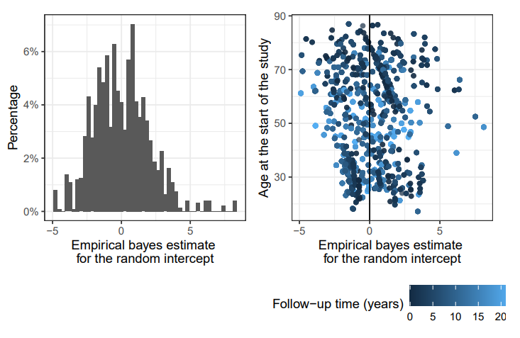
Random intercepts are generally used as indicators of individual differences. Here, It can be seen that there are some outliers with high random intercepts, meaning that these subjects have higher than expected hearing threshold i.e. a higher than expected probability of hearing loss.

Slide 8
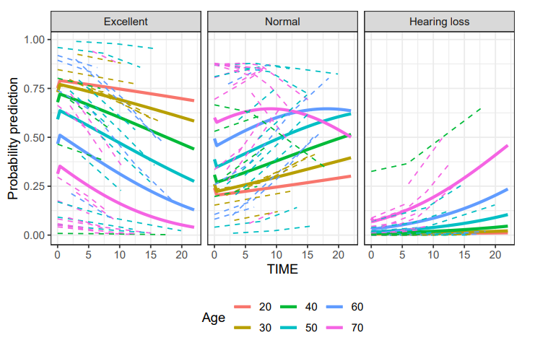
Figure shows predicted evolution for a each subset of subjects that have an age that is at most 1 year older or younger than the shown marginal evolutions.

Slide 9
Transition Models
Transition models are a special case of conditional models where a measurement in a longitudinal sequence is considered as a function of previous outcomes or history.
Transition models will be extremely useful when our interest is to see what will happen to the categorical responses from one moment to another.
Since the main research questions are related to the long-term evolution of hearing thresholds and not predicting the next measurement based on the current one, transition models are likely not ideal conceptually.
They require a balanced dataset (with equal amount of measurements for each subject) for accurate analysis. The dataset we are dealing with is unbalanced.
Suggests multiple imputation for balancing the data.
Another issue we face while trying to use transition models on our data is the irregular spacing of the measurements

